Slide 1
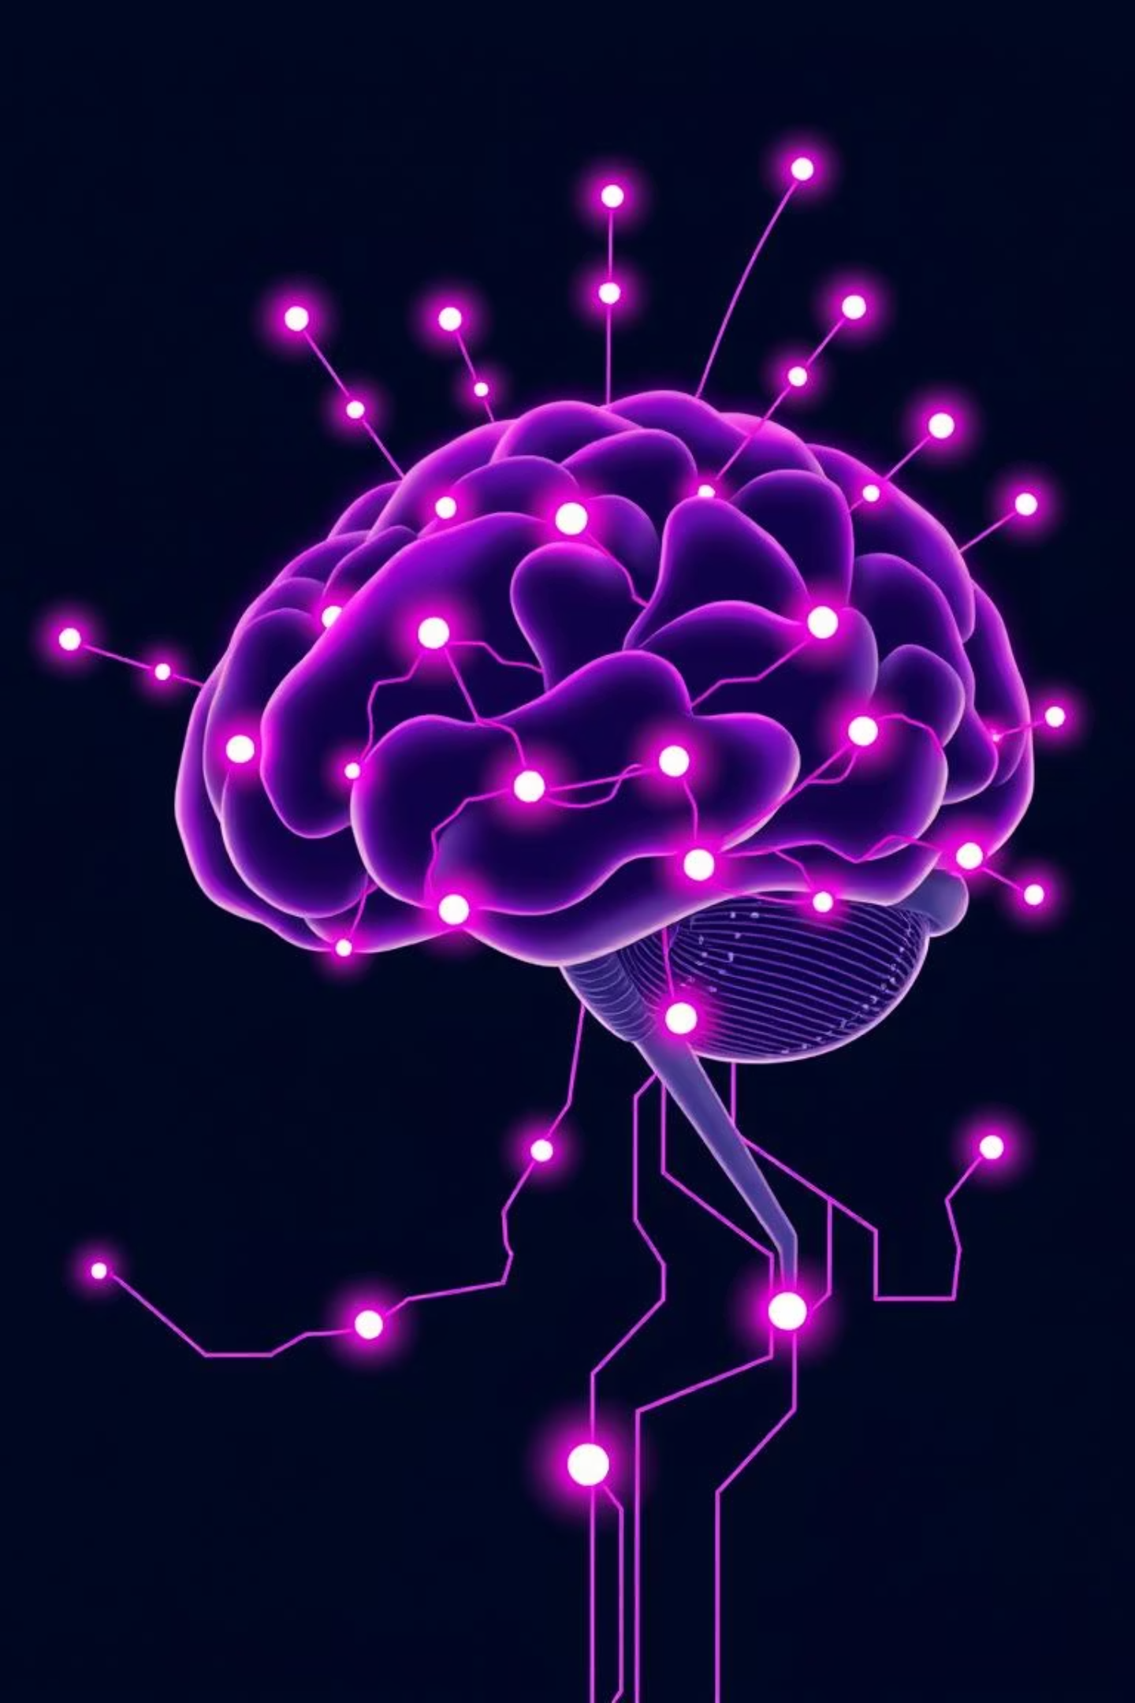
AI-POWERED RCA HUB

Slide 2




Global Scope Setup & Core Table Creation
Our initial step involved creating the AI Root Cause Log table without App Engine Studio, ensuring a global application scope.
Table Creation
Field Definition
Incident Table Customization
Defined 'AI Root Cause Log' table in System Definition, setting its application to Global.
Added fields like Related Incident, CI Name, Root Cause Summary, and GPT-related fields.
Customized the Incident table with 'Is RCA Triggered' and 'AI RCA Summary' fields.

Slide 3

GPT API Integration
ServiceNow was connected with OpenAI to generate RCA summaries using GPT.
REST API Creation
Configured a new REST Message for 'ChatGPT Integration' with the OpenAI endpoint.
HTTP Headers & Body
API Testing
Set Authorization and Content-Type headers, and defined the request body with a dynamic user_prompt.
Tested the API with a sample prompt to verify successful output retrieval.

Slide 4
RCA Workflow in Flow Designer
Automated GPT-based RCA triggering upon incident creation or update.
Flow Configuration
Flow Steps
Created 'Trigger RCA via GPT' flow on the Incident table.
Retrieve Incident Record.
Triggered when an Incident is created or updated with 'Is RCA Triggered' set to true.
Script step to build the GPT prompt.
Call GPT API and parse the response.
Create a new record in AI Root Cause Log.
Update the Incident with the AI RCA Summary.

Slide 5
Auto-Generate Change Request
Implemented automatic Change Request creation based on GPT recommendations.
Conditional Trigger
Change Request Creation
Field Population
An 'If' condition checks if the GPT response contains keywords like 'patch', 'rollback', or 'recommend'.
If the condition is met, a new 'change_request' record is created.
Fields like Type, CI, Short Description (from GPT), and Assignment Group are automatically populated.

Slide 6
Virtual Agent + NLU Setup
Enabled users to trigger RCA through a conversational chatbot.
Plugin Activation
Virtual Agent Topic
Activated 'Virtual Agent' and 'NLU Workbench' plugins.
Designed a new topic triggered by 'report_incident_rca' intent.
NLU Model
Conversation flow asks for short description, CI, and details.
Created 'RCA Incident Model' with 'report_incident_rca' intent.
Creates an Incident with 'Is RCA Triggered' set to true.
Added sample utterances like "email not working".

Slide 7



Dashboards, Indicators & Reports
Visualized RCA impact and tracked AI performance with comprehensive analytics.
Performance Analytics
Indicator Creation
Dashboard & Reports
Activated Incident and Change Management content packs for enhanced reporting.
Created an indicator for '# of RCA Events' on the AI Root Cause Log table, broken down by CI Name.
Designed a dashboard with RCA event indicators, logs, and a line chart for GPT-generated changes.

Slide 8
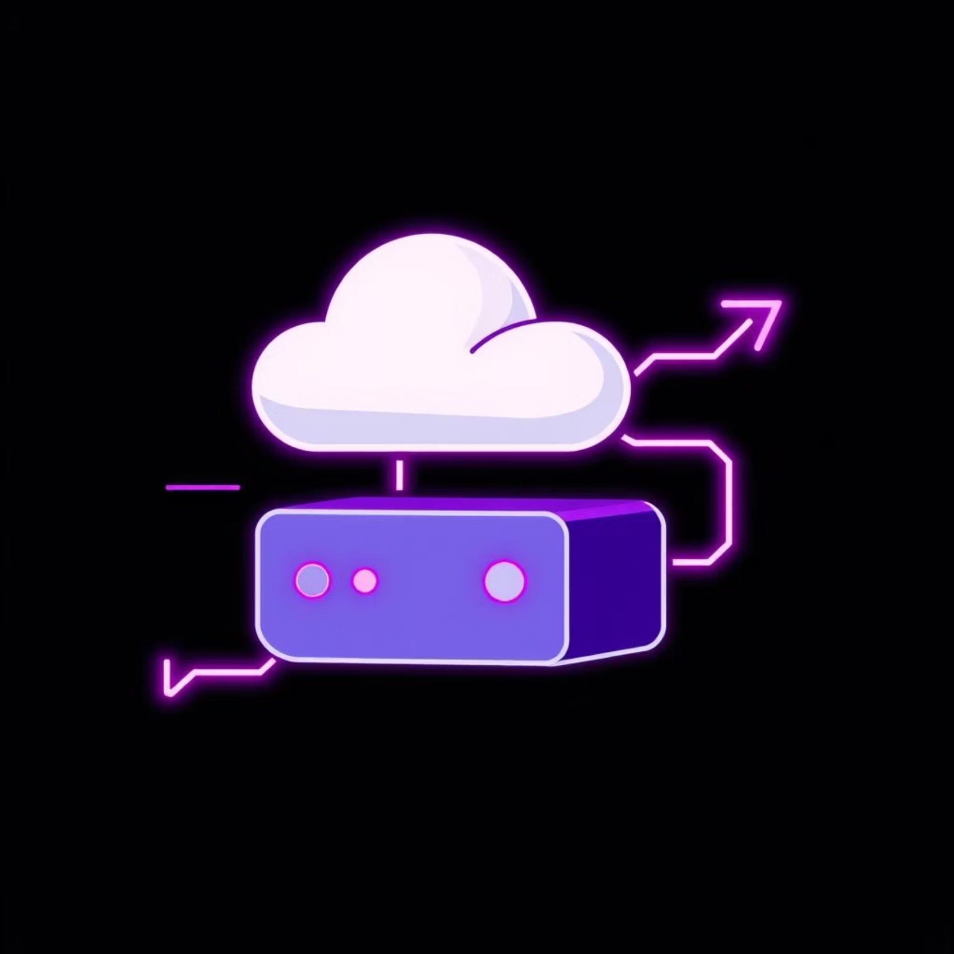
Bonus: Export & Deploy
Ensuring reusability and easy deployment of the solution.
Update Set (Global Scope)
Created 'AI_RCA_Project_Global' update set for easy export and reuse.
Ensured all necessary items were included for deployment.

Slide 9

Thank You

